Slide 1

RNS Institute of Technology (AICTE Approved, VTU Affiliated and NAAC ‘A’ Accredited) Department of Information Science and Engineering (Accredited by NBA for the Academic Years 2018-19, 2019-20 and 2020-21) Data structures Laboratory-18CSL38
ATM Transactions
Staff in Charge: Mrs. Kusuma K R
Designation: Assistant Professor
Carried out by :
Sumit Kushwaha (1RN19IS159)
Suraj Chaudhary (1RN19IS162)
Yash Pathak (1RN19IS185)

Slide 2
CONTENTS
> Abstract
> Introduction
> Objective of the project
> Data Structure
> Project Architecture
> Implementation modules
> Results
> Conclusion & Future Enhancements

Slide 3
ABSTRACT
The project demonstrates the working of atm machine. The program is build with C Language. The program first authenticates the user and upon successful authenticaton the user is asked what he wants to do in his account. The user can perform tasks like withdraw money, transfer money, change pin, balance enquiry & print mini statement in this program.

Slide 4
INTRODUCTION
As the program starts, the program asks user to enter his atm card number and his pin number. When the user enters correct credentials, it will provide the below options that can be performed in his account :
1. Withdraw : The user withdraws some amount from his/her account and after sucessful withdrawal his balance gets updated.
2. Transfer Money : The user can transfer money to other people account, after sucessful transaction the user and receiver’s balance gets updated.

Slide 5
3. Pin Change : User has a option to change his pin number allocated to his account.
4. Mini Statement : All the transactions processed through the users account will be displayed once the user selects this option.
5. Balance Enquiry : If the user selects this option, the amount available on the users account is displayed.
6. Back to Login Page : The user will be logged out from the program once he selects this option and after then another person can login into the program.

Slide 6
OBJECTIVE OF THE PROJECT
The objective of the project is to demonstrate the overall working mechanism of a real atm machine. In this project the user can experience all the features that are available in a real atm machine. Some pre-defined accounts have created in the project that can be used to perform the transactions and analyse different other options like pin change, mini statement & balance enquiry. In place of swiping atm card that happens in a real atm machine, a basic user authentication has been provided in the project.

Slide 7
DATA STRUCTURE
The data structures used in the project are :
1. Array
2. Single Linked List (SLL)
Array is used in this project to store users detail
like account number, atm card number, pin number, balance & phone number.
SLL is used to store all the transactions occuring in the atm. It contains field like user account number(sender), receiver account number, transaction amount & a link.

Slide 8
FLOWCHART :
START
Print “Welcome”
INPUT:
Card No & PIN
INVALID
Authenticate
User
VALID
Print Optioins:
1.WIthdraw, 2.Transfer Money
3.Pin Change, 4.Mini Statement, 5.Balance Enquiry, 6.Back to login page, 7.Exit

Slide 9
choice
case 1
YES
Enter Amount to withdraw
FALSE
NO
if(amount>0 && amount<balance)
TRUE
Update balance in Account
Update transaction in Linked List
Print Withdrawal success

Slide 10
case 2
YES
Input : Receiver’s Account No & amount to transfer
NO
Confirm Receiver Account No
FALSE
If(amount>0 && amount<balance)
TRUE
Update Sender’s & Reciever’s balance
Update transaction in Linked List
Print Transaction sucessful

Slide 11
case 3
YES
Input : 4 digit new Pin
NO
Confirm Pin
if(pin>0)
FALSE
TRUE
Print :
Pin Changed
case 4
YES
Check transactions in Linked List where user is sender or receiver
NO
Print : matching transactions

Slide 12
case 5
YES
Print : User’s Account Balance
NO
case 6
YES
goto Authentication Page
NO
case 7
YES
NO
default
exit(0)
STOP

Slide 13
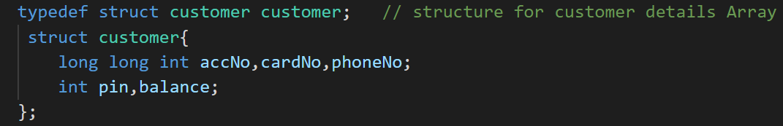
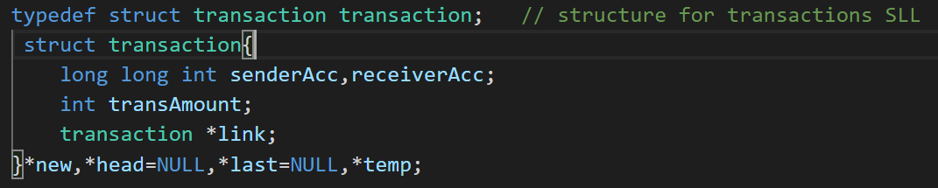
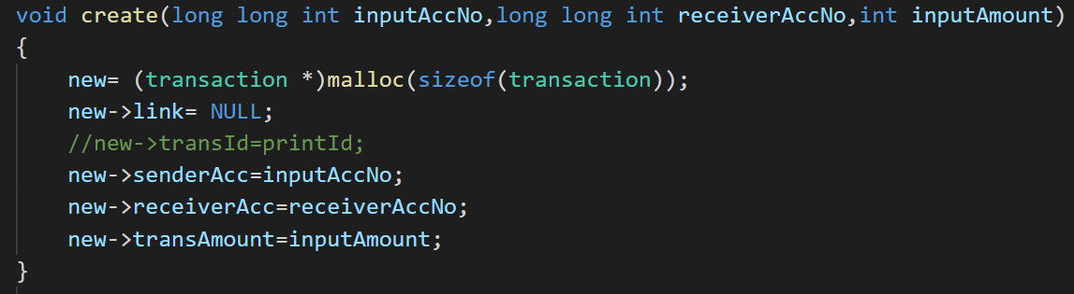
Here, customer data type is defined with the help of struct keyword. An array is declared of type customer which holds all customers’ details. This data type has the following fields :
Account Number, Card Number, Phone Number, Pin Number & Balance of the account.
In this declaration, transaction data type is defined which will store all the transactions processed by the customers. A single linked list is implemented of type transasction that will have the following fields: Sender’s account number, Receiver’s account number, transaction amount & a link field that will help to connect the nodes of linked list.
To store the transactions, single linked list is used which is created with the help of create function. This create function creats a new node and assigns the data which are given as it’s arguments.

Slide 14
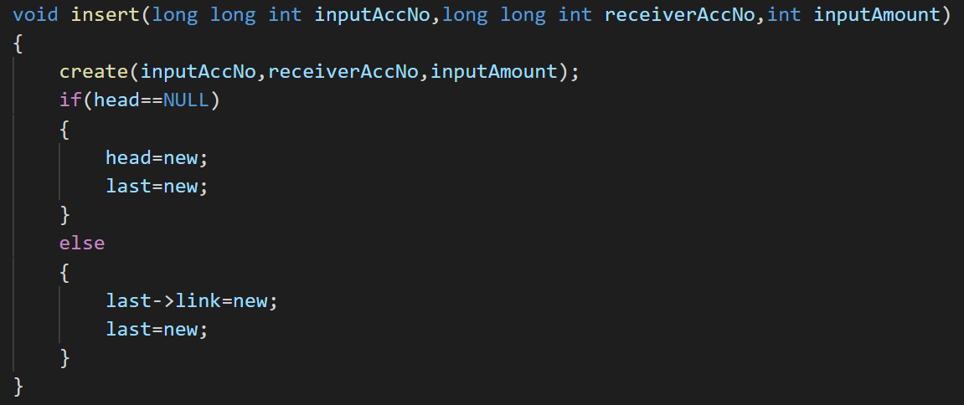
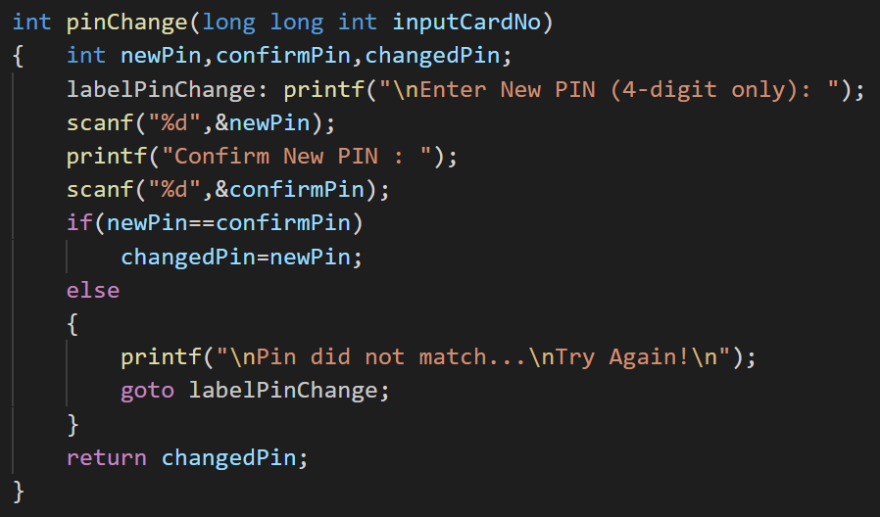
The insert function helps to connect nodes in the single linked list. This function takes the arguments : current user’s account number, receiver’s account number number and transacton amount. These arguments will be passed to create function which will assign these data into corresponding fields of new node. After assiging values the insert function will link this newly created node to the linked list.
This function will help user to change his pin. When this function is called it will ask user to enter a 4 digit new pin, it will ask user to confirm this new pin by passing again the same pin. If both pin matches then it will return this pin to the program for further processing, but if pins do not match then the user have to try again giving new pins.

Slide 15
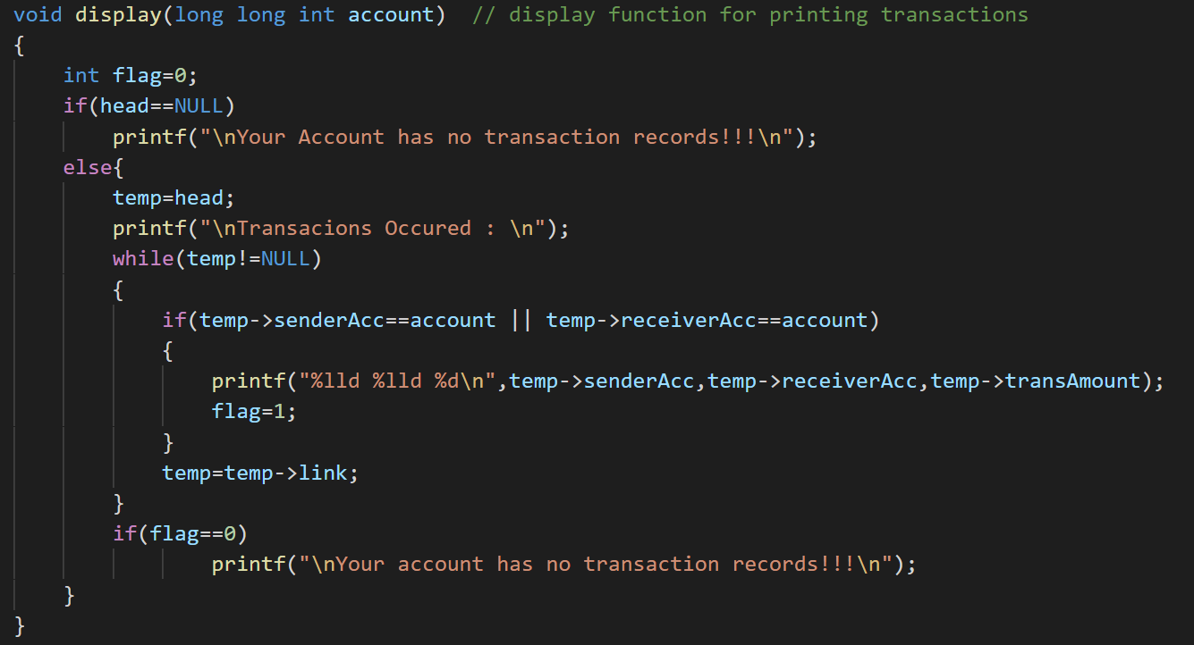
Display fuction will display all the transactions that contains the user account number either in sender account number field or in receiver account number field. This function takes user account number as argument and prints sender account number receiver account number and transaction amount.

Slide 16
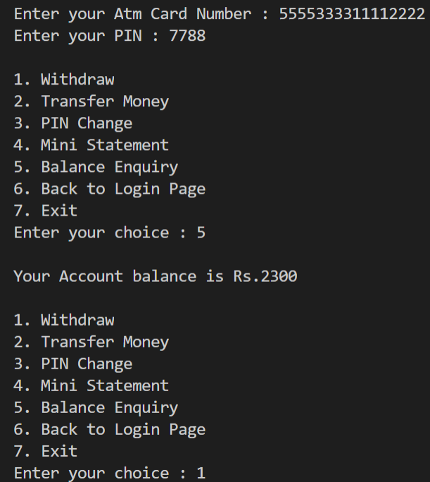
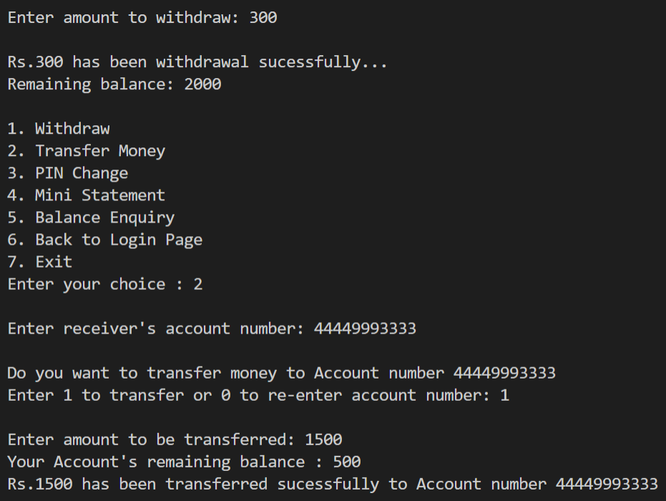
RESULTS
1.
2.

Slide 17
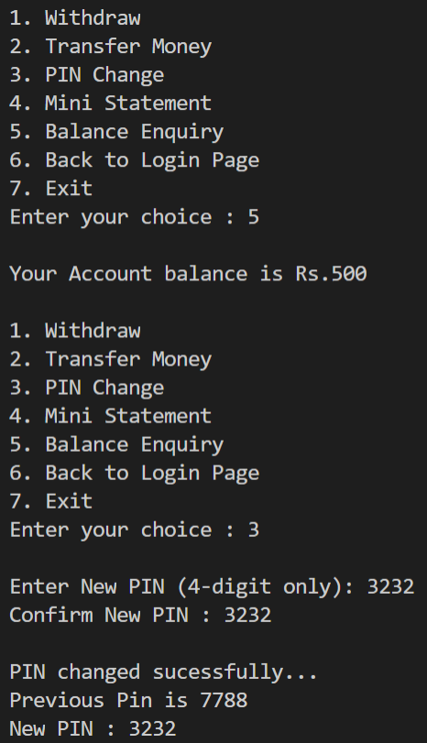
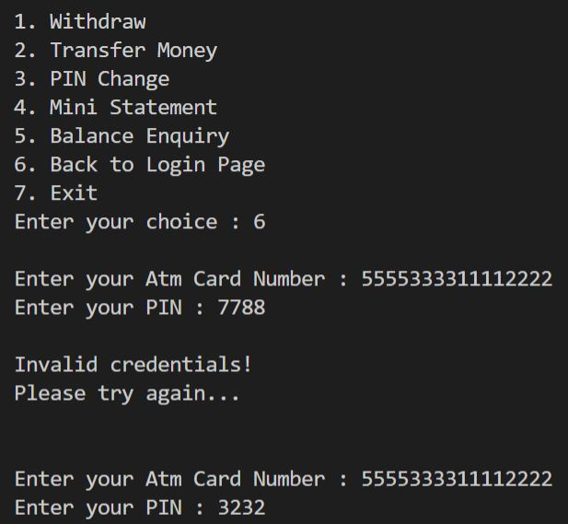
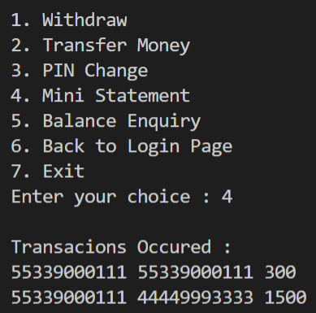
3.
4.
5.

Slide 18
Future Enhancements
Further looking towards the future enhancement, we will add file systems to the project that will help us to store and updated data. This will resolve current problem of updating data. In the current project, once the program is exited all data and transactions processed will be lost and every time we run the program we need to start with the compile time assigned data to the array and an empty single linked list.
But if we use file system we will always have the updated data and transactions stored in a file.

Slide 19
THANK YOU
Conclusion
With the help of this project we can realize the overall working of a ATM machine.
We are able to perform operations like withdrawal, transfer money, pin change, display mini statement and check balance of accounts which are already defined in the program.

